Slide 1

Anime recommendation system

Slide 2
Problem Statement
Anime recommendation system based on different genres distribution, user’s rating, popularity and Past preferences of the user.
We plan to recommend the anime based on the user’s personal choice. Their individual decisions vary with the time and change with the many series he watched.

Slide 3
Dataset
https://www.kaggle.com/hernan4444/anime-recommendation-database-2020?select=animelist.csv
user_id | non identifiable randomly generated user id.
anime_id | MyAnemlist ID of the anime. (e.g. 1).
Genres | comma separated list of genres for this anime.
Popularity | position based in the number of users who have added the anime to their list.
Rating | rating that this user has assigned.

Slide 4
Ranked | Position based in the score.
Popularity | Position based in the number of users who have added the anime to their list.
Watching | Number of users who are watching the anime.
Completed | Number of users who have complete the anime.
Dropped | Number of users who have dropped the anime.
Planning to watch | Number of users who plan to watch the anime.

Slide 5
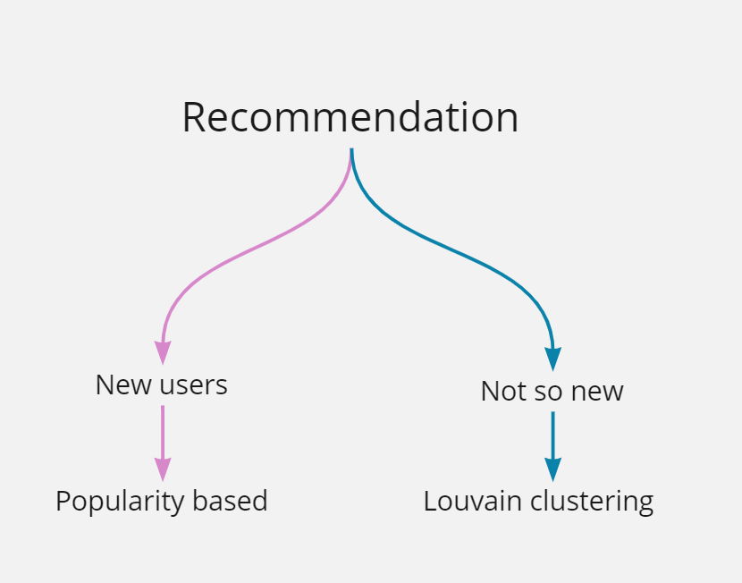

Slide 6
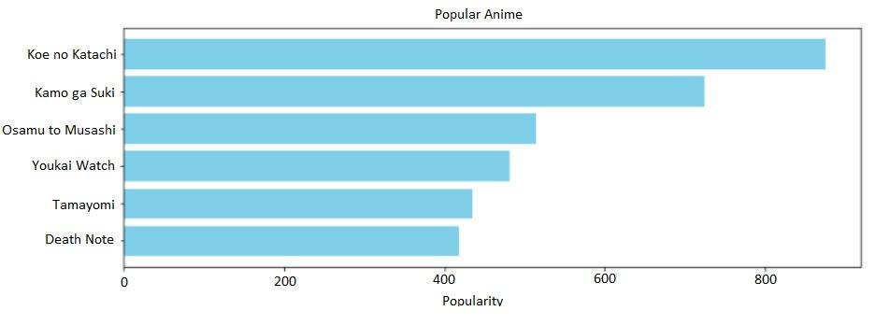
Not so new user
Wt.avg of users who have kept that anime in their favourites

Slide 7
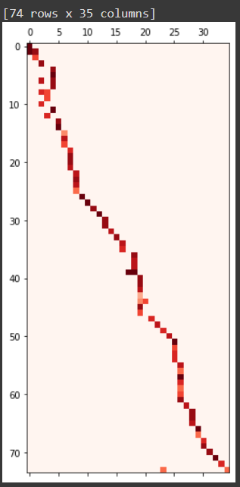
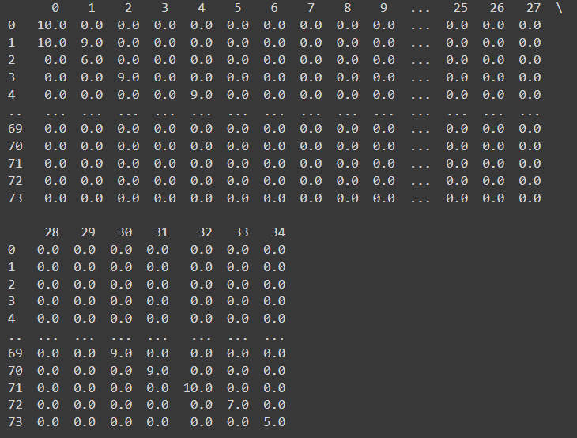
Nodes: users & anime
Co clustering for simultaneous clustering

Slide 8
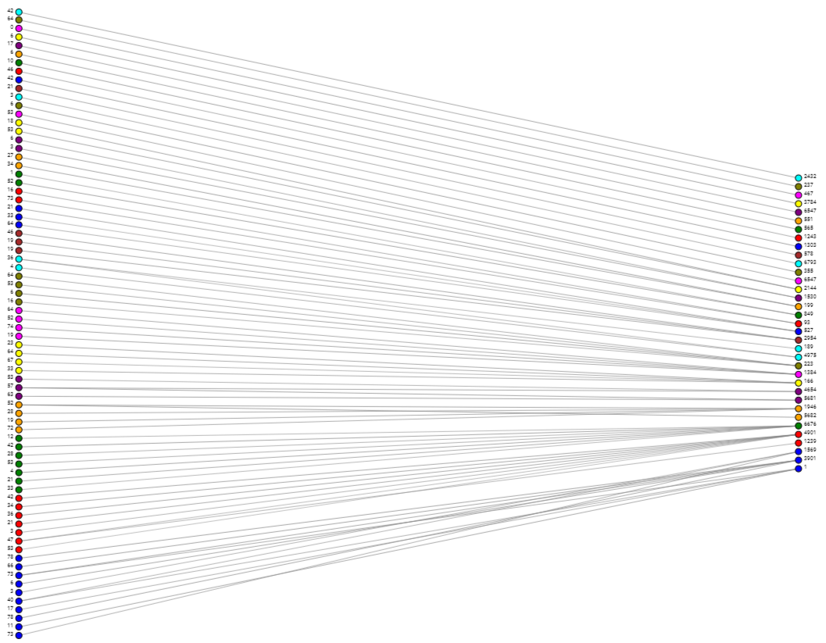
Problem with lauvain:
Does not return mapped nodes or cluster

Slide 9
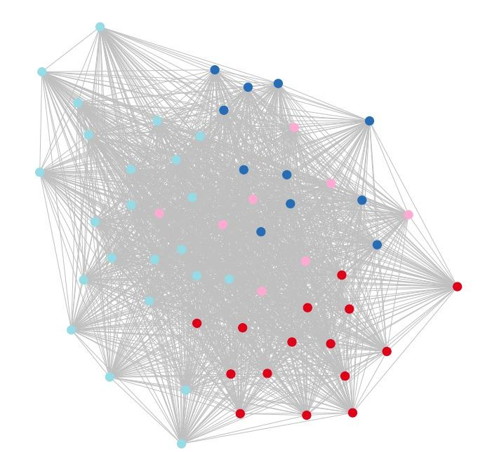
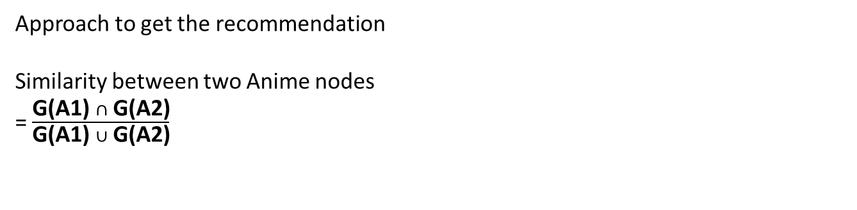
Clustering of anime

Slide 10
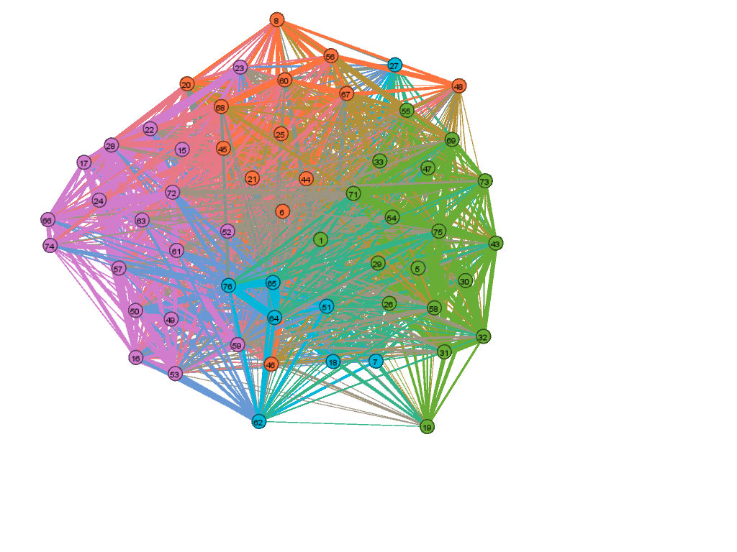
45: akira - Action, Military, Sci-Fi, Adventure, Horror, Supernatural, Seinen
75: Dead Aggressor - Action, Mecha, Military, Sci-Fi, Drama
30: Neon Genesis - Action, Sci-Fi, Dementia, Psychological, Drama, Mecha

Slide 11
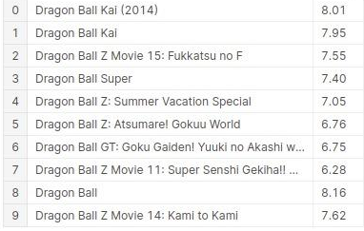
Recommendation result

Slide 12
https://proceedings.neurips.cc/paper/2018/file/53f0d7c537d99b3824f0f99d62ea2428-Paper.pdf
(Zhang & Chen, Link Prediction Based on Graph Neural Networks, 2018)
https://towardsdatascience.com/building-a-recommendation-system-for-anime-566f864acea8
Anila Quereshi, Building A Recommendation System for Anime (2018)
https://www.researchgate.net/publication/342690182_Collaborative_Recommendation_Systemin_Users_ofAnime_Films
Girsang, A & Al Faruq, Barra & Herlianto, Hemdani & Simbolon, Sihar. (2020). Collaborative Recommendation System in Users of Anime Films. Journal of Physics: Conference Series. 1566. 012057. 10.1088/1742-6596/1566/1/012057.
https://arxiv.org/abs/1709.01584
(Vie, Using Posters to Recommend Anime and Mangas in a Cold-Start Scenario
2017)

Slide 13
Thank You

